Slide 1
Safe driver prediction
Team member
1) QUEK YAO JING (B031810136)
2) NOR HAQKIEM BIN HAMDAN (B031810172)
3) MOHAMAD FIRDAUS BIN MOHD JAFRI (B031810072)
4) AMIRAH NABILAH BT AHMAD NAZARI (B031810113)

Slide 2
INTRODUCTION
OBJECTIVE
To predict whether driver is a safe or unsafe driver and suggest package of insurance if they are unsafe driver.
AIMS
To do data exploration on the dataset to find the hidden insight.
To perform several feature engineering in order to predict data.
To experiment with several different model for the purposes of finding the best accuracy of the model.
PREPARATION OF DATA
Retrieved from https://www.kaggle.com/ which consist variety of open source dataset

Slide 3
(QUEK)
RETRIEVE , REPLACE AND BALANCING DATA (Preprocessing)
- Dataset highly imbalanced
- Bias occur if did not do anything in preprocessing data
- Under sampling is used to stratified sample class consist higher number rows to make It balanced between 2 classes
- Imputer is used to handle missing value in the dataset
- All missing value will be replaced with median value

Slide 4
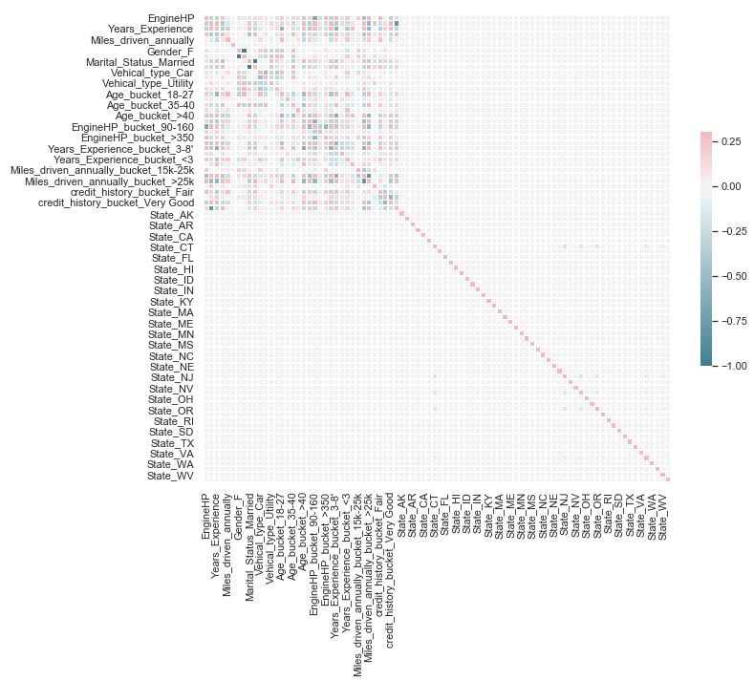
(QUEK)
IMPLEMENTING DATA EXPLORATION TASK IN PYTHON
The correlation graph shows that attribute that does not correlated with each other’s will be indicate in dark blue in color

Slide 5
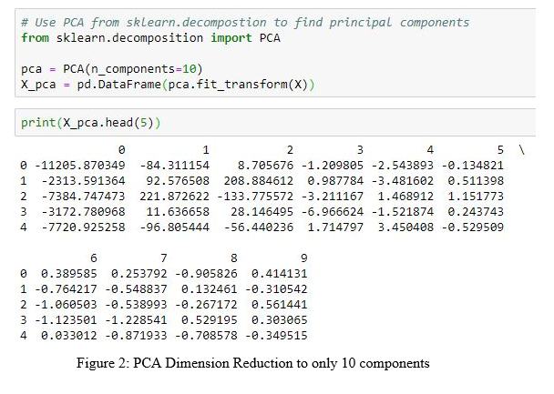
(QUEK)
FEATURE REDUCTION
- Too many of feature might overfit the dataset. Therefore we need dimension reduction algorithm to reduce its dimensions
i) PRINCIPLE COMPONENT ANALYSIS (PCA)

Slide 6
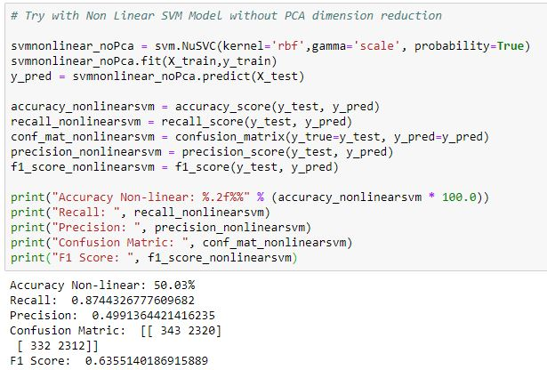
(QUEK)
ii) Non-linear Support Vector Machine (SVM)
Figure 4: Python Code to
run Support
Vector Machine

Slide 7
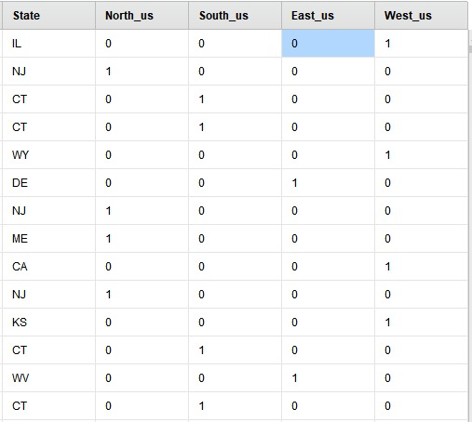
Tools (MYRA)
ATTRIBUTE GENERATION
- New attribute generated from existing attribute
STATE ATTRIBUTES

Slide 8
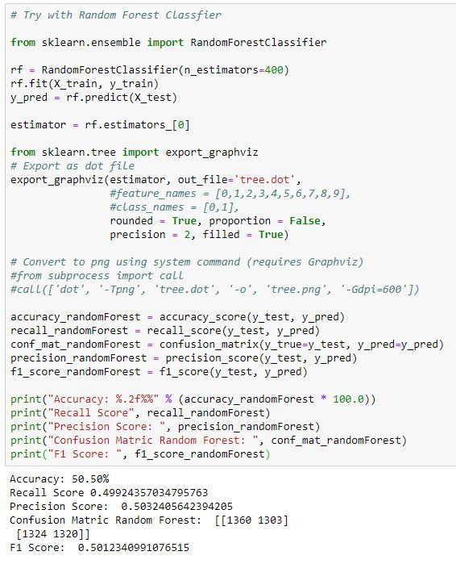
tools
MODELLING
i) Ensemble Model (Random Forest)
Figure 2: Python code to run Random Forest Classifier

Slide 9
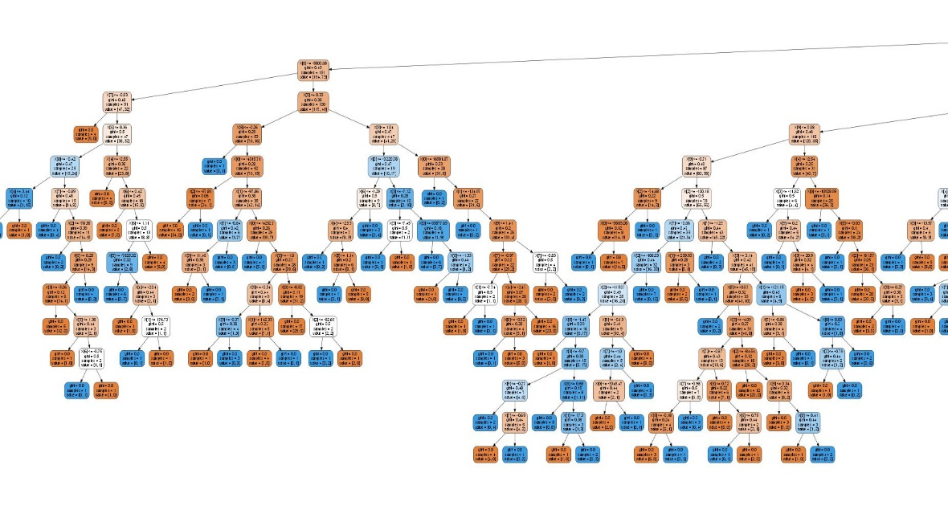
Figure 3: Part of the Random
Forest Classifier

Slide 10
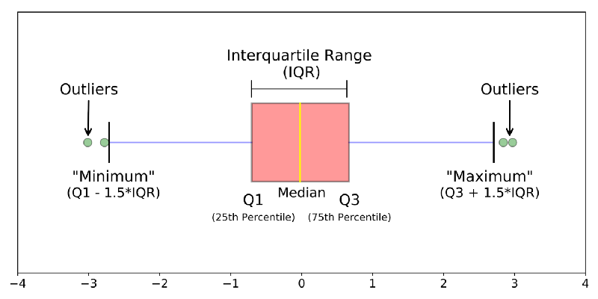
Tools (daus)
Data Exploration
a data analyst uses visual exploration to understand what is in a dataset and the characteristics of the data
i) BOXPLOT
Boxplot is a standardized way of displaying the distribution of
data based on a five number summary
(“minimum”, first quartile (Q1), median,
third quartile (Q3), and “maximum”).
It can tell you about your outliers and what their values are
Figure 3: Diagram shows there’s an outlier in the boxplot.

Slide 11
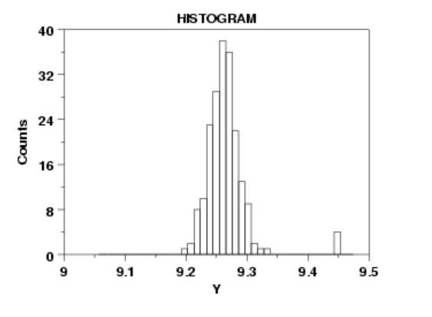
ii) HISTOGRAM
A graphical display of data using bars of different
heights
Each bar groups numbers into ranges
Taller bars show that more data falls in that range
A histogram displays the shape and spread
of continuous sample data.
Figure 4: Diagram shows there’s an outlier in the histogram diagram.

Slide 12
Tools
ii) Backward Elimination
iii) Forward Elimination
iv) Brute Force

Slide 13
Tools (AKEM)
FEATURE SELECTION
A dataset consists of various features but not all features are important for data mining process. The importance of a certain features can be identified using selection technique as follows:-
i) Select by Weight
Selects only those attributes of the dataset whose weights satisfy the specified criterion with respect to the input weights.
Input weights are provided through the weights input port
Criterion for attribute selection by weights is specified by the weight relation parameter

Slide 14
ii) Select by Random
selects attributes randomly from the dataset
The randomization can be changed by changing the seed value in the corresponding parameters.

Slide 15
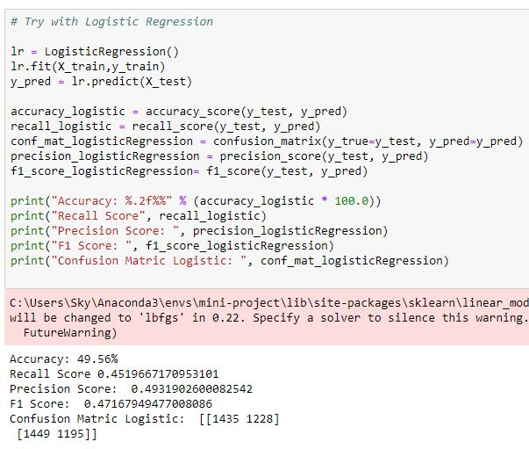
iii) Logistic Regression
Figure 5: Python Code to
run Logistic
Regression

Slide 16


ACCURACY AND MEASUREMENT
Table 1: Model with F1-Score before
feature engineering
Table 2: Model with F1-Score
after feature engineering

Slide 17
QUESTIONs
(QUEK)
Why we cannot measure the completeness using accuracy but need to depend on the F1-score?
Why is F1 Score and not Recall or Precision?

Slide 18
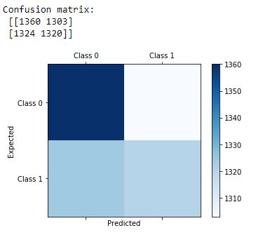
The accuracy is measured by a few techniques
(QUEK)
i) Confusion Matrix
A confusion matrix of our safe driver dataset produced 2 by 2 table formed by counting the number of 4 outcomes of binary classifier.
Name them as TP, FP, TN, and FN.
Figure 6: Example of the confusion Matrix
which consist of
TP = 1320,
TN =1360,
FP = 1324,
FN = 1303.

Slide 19

(QUEK)
ii) Accuracy
Accuracy is one metric for evaluating classification models
This evaluating metric is not suitable for certain cases such as imbalance class in a dataset. In imbalance class, certain class has greater amount of dataset than the other class
Accuracy is measure by Number of correct predictions which contains TP and TN divided by Total number of predictions.
Figure 7: Formula of the accuracy

Slide 20

(QUEK)
iii) Recall
Recall is the ability of a model to find all the relevant cases within a dataset
Recall is the number of true positive divided by the number of true positive plus the number of true negatives.
In our case, our recall will be number of correctly identified unsafe driver divided by the number of correctly identified unsafe driver plus the unsafe driver that is incorrectly labelled as safe driver.
Figure 8: Formula of the Recall

Slide 21

(QUEK)
iv) Precision
Precision attempt to find the proportion of positive identification was correct.
Precision taken account of the data how many times the models makes false positive prediction.
For example, precision taken account of the data on how many times safe driver is prediction as unsafe driver
Figure 9: Formula of the Precision

Slide 22
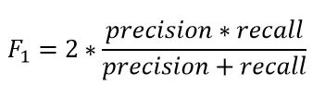
(QUEK)
v) F1 Score
F1-score is the harmonic means of the precision and recall by taking both metrics into account
In our case we have to maximize the F1 score.
Figure 10: Formula of the F1 Score

Slide 23
conclusion
Can be concluded that non-linear SVM obtained the best model with accuracy of 63.55%.
This dataset is non-linear and models such as XGBBoost, LightBoost, Neural Network or Deep Learning method able to achieve higher accuracy
model or technique that is really good in handling non-linear data.

